Slide 1

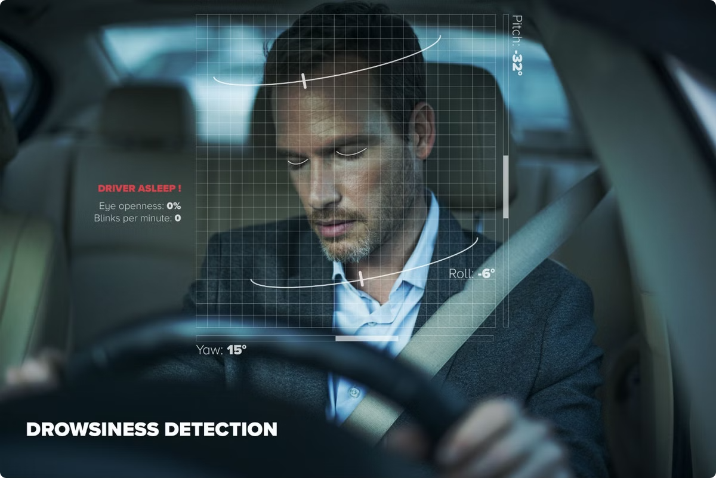
Driver Drowsiness Detection System
NAME ROLL NO
SRIYA PANADA 2106265
ANIKET V 2106295
UJJWAL SINGH 2106274
HIMANSHU DASH 2106117
PRAKASH KUMAR 2106132
ALTAMASH DANYAL 2106032

Slide 2
Introduction
Objective
Significance
Scope
Reduce accidents by proactively detecting driver fatigue before it leads to dangerous situations.
Road safety enhancement.
Applications for personal, commercial, and public transportation.
Integration of cutting-edge deep learning techniques.
Real-time monitoring and alert systems.

Slide 3



Problem Statement
Driver Fatigue
1
A leading contributor to road accidents globally.
Challenges
2
Variability in lighting, obstructions, and diverse physiological profiles.
Proposed Solution
3
Real-time, reliable drowsiness detection and alert system, scalable for diverse use cases.

Slide 4
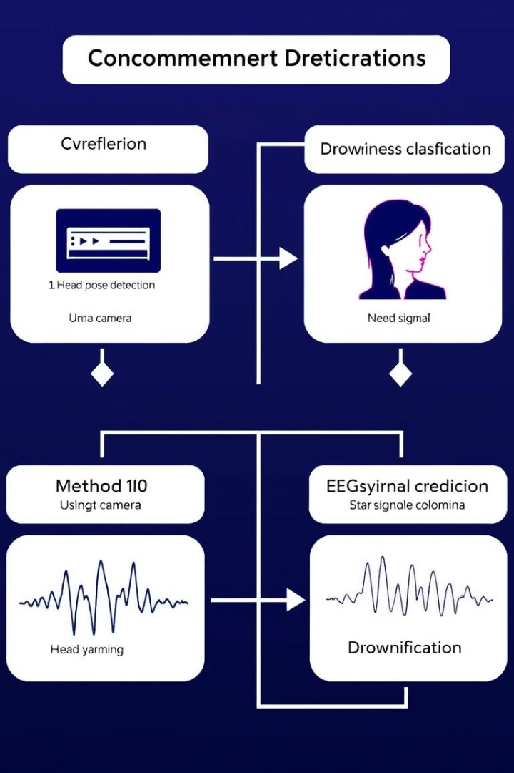


Proposed Methods
YOLOv5-Based Detection
CNN and Flask Integration
Object detection for facial features.
Real-time analysis with TensorFlow-based CNN, providing a user-friendly web interface via Flask.
High-speed processing (~30 FPS).

Slide 5
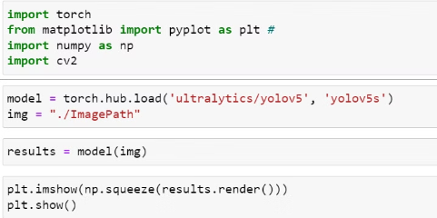
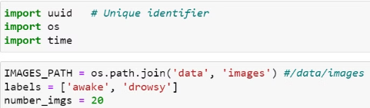
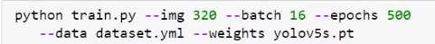
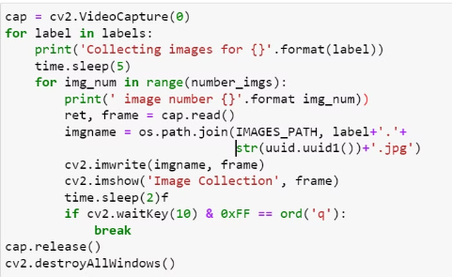
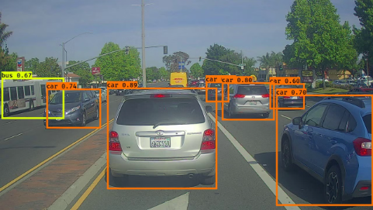
Yolo Implementation
1
Model Testing
2
Data Preparation
3
Model Training
Prepare YOLO data by labeling images and formatting annotations.
feeding labeled images into a neural network to optimize weights for detecting and classifying objects within bounding boxes in real-time.
Testing a YOLO model evaluates its detection accuracy and speed on unseen data.

Slide 6
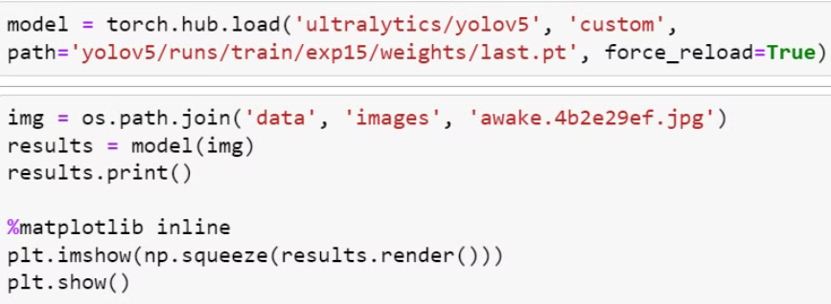
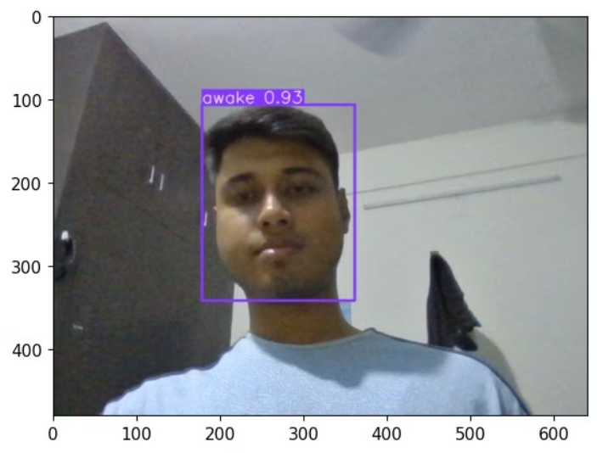
Custom Model Testing
A custom YOLO model was tested on an input image to detect specific features or objects. The detection results, including bounding boxes and class labels, were visualized directly in a Jupyter Notebook using Matplotlib's pyplot.
Output
The YOLO model successfully detects the presence of a person in the frame and classifies their state as "awake". The bounding box highlights the detected region, demonstrating the model's effectiveness in identifying and classifying human states.
Result and Problems with Yolo
Our YOLO-based model is successfully detecting whether a person is drowning or awake, providing critical insights for safety monitoring. However, the current implementation faces limitations in tracking finer details, such as the eyes of the person. This highlights a need for further refinement or integration with specialized models to enhance its capability for detecting smaller, detailed features critical for advanced analysis.

Slide 7

Implementation
Data Preparation
Model Training
Utilizing datasets like MRL Eye for model training and evaluation.
Fine-tuning YOLOv5 and CNN models for object detection and drowsiness classification.
Backend Integration
User Interface
Leveraging Flask for API development and real-time model interaction.
Developing web-based (HTML, CSS, JS) and desktop-based (Tkinter) interfaces for user interaction and analysis.

Slide 8
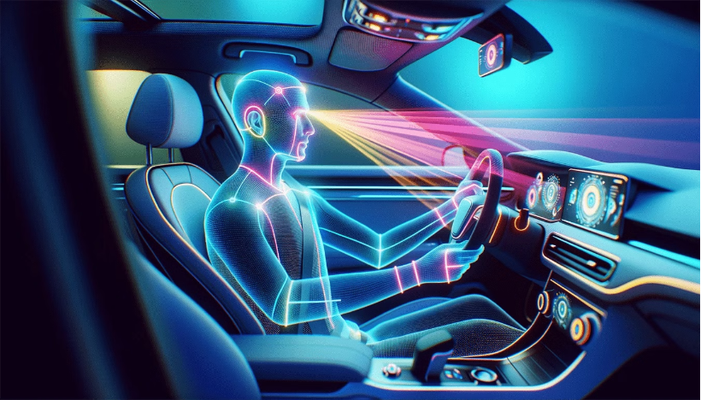
CNN and Flask Integration for Drowsiness Detection
Overview
Objective: Real-time drowsiness detection using CNN.
Components:
TensorFlow CNN for eye-state classification.
Flask backend for video processing and analytics.

Slide 9
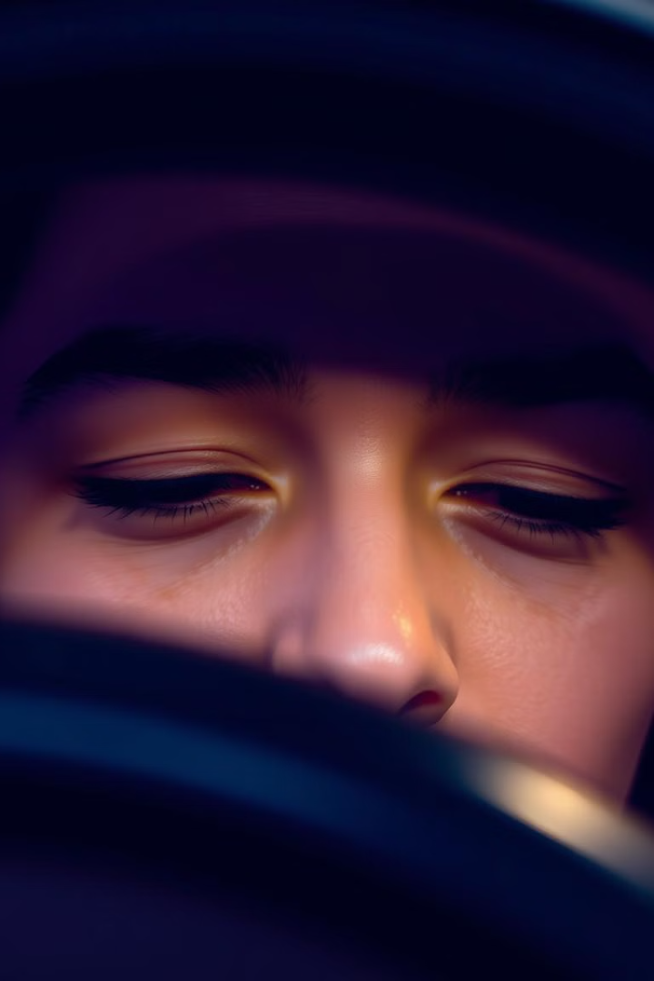
Real-Time Drowsiness Detection Using CNN
The drowsiness detection system employs a Convolutional Neural Network (CNN) to analyze video frames, specifically focusing on the driver's eyes. This system uses real-time video processing to detect signs of drowsiness, ensuring a proactive approach to driver safety.

Slide 10
Key Features & Technology Stack
Key Features
Technology Stack
Web-based interface for real-time updates and analytics.
HTML, CSS, and JavaScript for the frontend user interface.
High-accuracy CNN for drowsiness detection using OpenCV.
Flask and TensorFlow for the backend logic and model processing.
Configurable alerts via web interface.
OpenCV for real-time frame analysis and image processing.
This system enables proactive driver safety by identifying drowsiness and providing timely alerts.
Pygame for audio notifications.

Slide 11
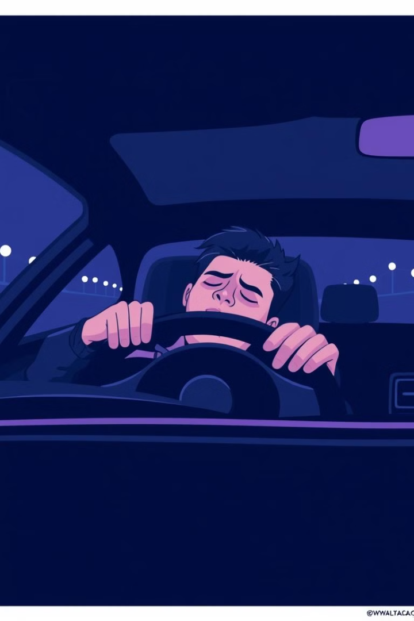
Use Cases
Personal Vehicle Monitoring: For long drives, the system can help drivers stay alert and avoid fatigue-related accidents.
Fleet Management: Companies can implement the system in their fleet vehicles to ensure driver safety and reduce risks associated with drowsiness.
Enhanced Road Safety: By detecting and alerting drivers to drowsiness, the system contributes to safer roads for all drivers.

Slide 12
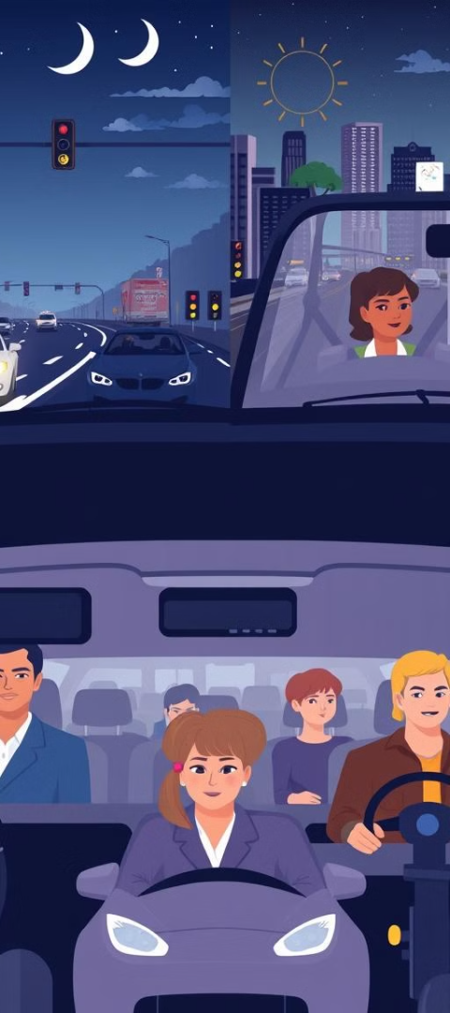



Error uploading image.
Future Enhancements
Head Pose Estimation
Incorporate head pose estimation to detect drowsiness signs beyond eye closure, improving accuracy.
Mobile Interface
Develop a mobile-friendly interface for broader accessibility and convenience.
Adaptive Lighting
Enhance the system to adapt to varying lighting conditions, ensuring consistent performance.

Slide 13
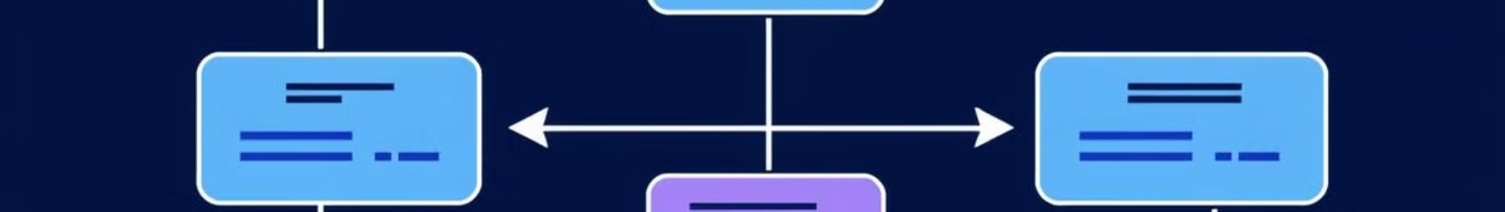
System Design
Input
Output
Real-time video feed from various sources, like car cameras or webcams.
Visual overlays on the video, audio alerts, and an analytics dashboard for monitoring.
1
2
3
Processing
Preprocessing, feature extraction, and drowsiness detection using the trained model.
Design Constraints:
Hardware requirements (e.g., webcams).
Challenges with lighting and obstructions.

Slide 14
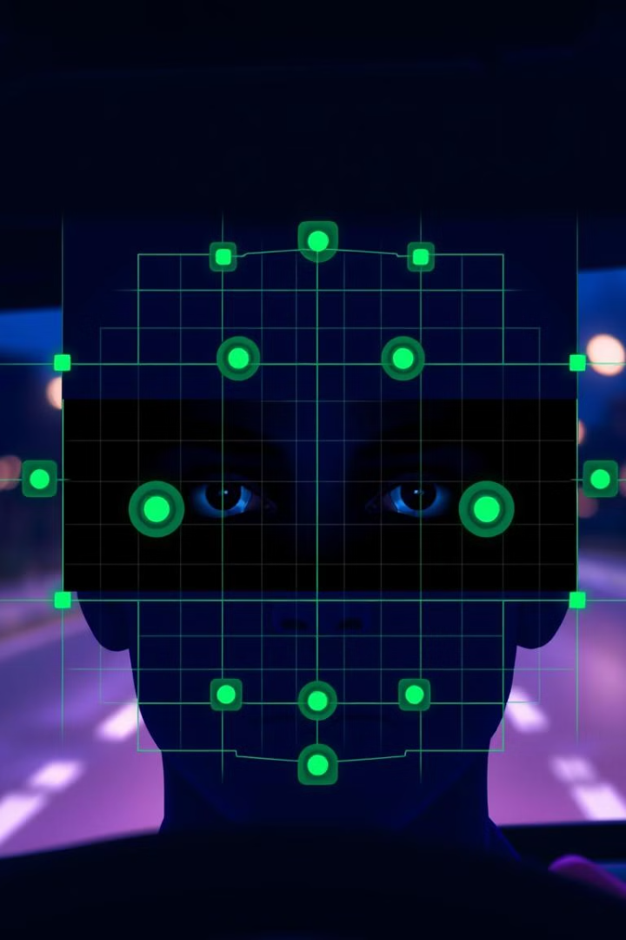




System Workflow
Data Preparation
The dataset consists of labeled images of open and closed eyes. This data is crucial for training the CNN.
Model Training
A CNN is trained on the preprocessed dataset to learn the patterns of open and closed eyes. The model achieves high accuracy in classifying eye states.
Real-Time Detection
The Flask backend processes video frames captured from the driver's camera in real-time.
Analytics Dashboard
The system tracks various metrics for analysis and performance monitoring.

Slide 15
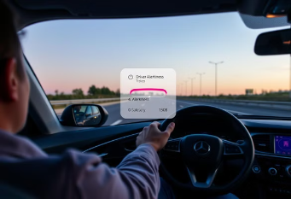
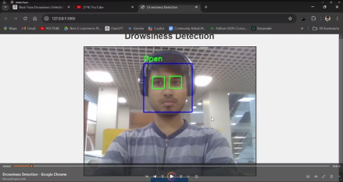
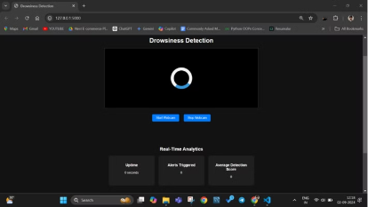
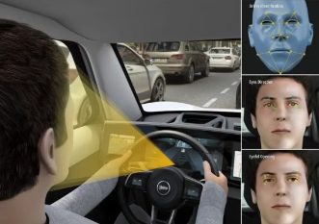
Results and Discussions
Results Overview:
High accuracy and real-time detection.
Scalability across platforms.
Observations:
Strengths: Robust detection, low latency.
Limitations: Challenges with obstructions, lack of head pose detection.

Slide 16
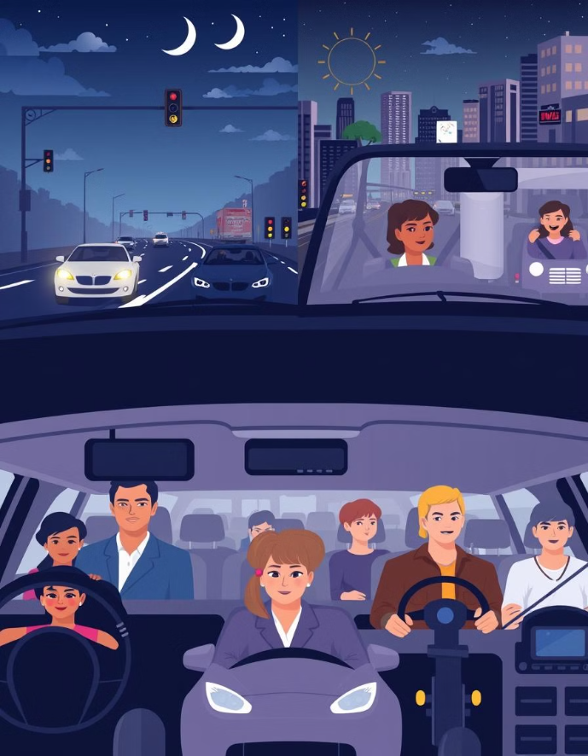
Error uploading image.
Future Scope
IoT Integration: Enable seamless deployment in smart vehicles.
Mobile Applications: Develop apps for Android and iOS platforms.
Head Pose Estimation: Add algorithms to track head tilts or nodding.
Blink Rate Monitoring: Include abnormal blinking patterns for early fatigue detection.
Advanced Algorithms: Explore 3D-CNNs for enhanced analysis.
Environmental Adaptation: Implement sensitivity adjustments based on lighting and environmental conditions.
Yawn Detection: Extend detection capabilities with mouth movement analysis.
Integration with Vehicle Systems: Include features like automatic braking and alerting the passenger system.

Slide 17
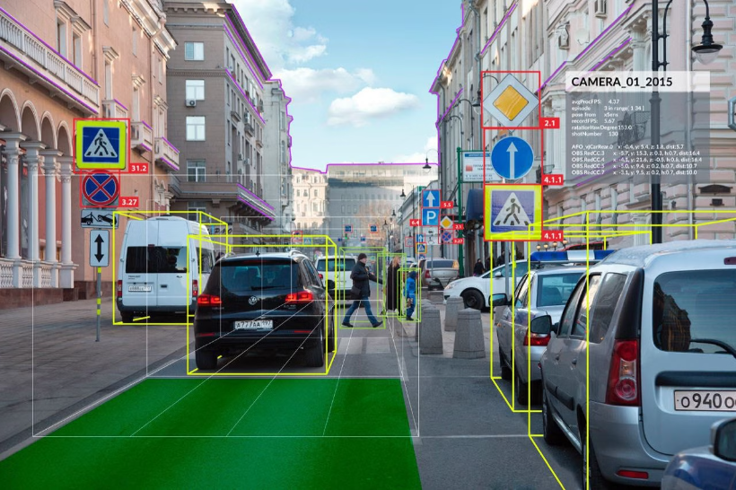
Conclusion
Summary:
Effective real-time detection.
Scalability for personal and commercial use.

